Slide 1



MAVERICKS GEN AI DESIGNATHON
THE DATANAUTS

Slide 2

TEAM DETAILS
THE DATANAUTS
SMART RECRUITING PLATFORM.
Team Members
EMP ID
ASHWIN B S 2000081228
GURUPRASAD SUVARNA 2000081298
RITESH SAH 2000130674
RITIK DIYUNDI 2000108348

Slide 3


Impact/Potential Value of the Application
Streamlined Recruitment Process: Our smart recruitment platform accelerates hiring by automating key tasks, reducing manual effort, and enabling faster decision-making.
AI-Driven Precision: Leveraging advanced AI, the platform ensures accurate candidate matching and efficient evaluations, improving the quality of hires while saving time.
Enhanced Candidate Experience: By minimizing delays and streamlining communication, the platform fosters a seamless and engaging recruitment journey for both candidates and recruiters.
98%
Client Satisfaction

Slide 4

The Solution Proposed by your Team
Solution Highlight
Transforming recruitment with end-to-end AI automation: Our platform leverages machine learning for precision-driven recommendations, automated resume building, seamless job postings, and intelligent candidate assessments. By integrating AI-powered interviews and tests, we deliver a faster, fairer, and more engaging hiring process, enhancing the experience for both candidates and recruiters.

Slide 5
The Solution Proposed by your Team
Key Features
Automated Resume Building: AI-driven tools auto-complete and optimize resumes, ensuring professional quality and alignment with job requirements.
Seamless Job Creation: AI simplifies the process of crafting well-structured and targeted job descriptions, tailored to attract the right candidates.
ML-Based Recommendations: Machine learning algorithms provide personalized job recommendations for candidates and relevant candidate matches for employers.
AI-Powered Assessments: Intelligent testing frameworks conduct skill-based evaluations with minimal human intervention, ensuring fairness and precision.
Virtual Interviews: AI-driven interviews assess candidates on communication, technical, and behavioral aspects, providing detailed analysis and insights.
Time Optimization: Automation reduces the time spent on redundant tasks, speeding up hiring cycles significantly.
Data-Driven Insights: Comprehensive analytics and reporting tools offer actionable insights to improve decision-making for recruiters and candidates.
Enhanced User Experience: User-friendly interfaces and intelligent workflows ensure a seamless experience for all stakeholders.

Slide 6
The Solution Proposed by your Team
Key Features of the Smart Recruitment Platform
Automated Resume Building: AI-driven tools auto-complete and optimize resumes, ensuring professional quality and alignment with job requirements.
Seamless Job Creation: AI simplifies the process of crafting well-structured and targeted job descriptions, tailored to attract the right candidates.
ML-Based Recommendations: Machine learning algorithms provide personalized job recommendations for candidates and relevant candidate matches for employers.
AI-Powered Assessments: Intelligent testing frameworks conduct skill-based evaluations with minimal human intervention, ensuring fairness and precision.
Virtual Interviews: AI-driven interviews assess candidates on communication, technical, and behavioral aspects, providing detailed analysis and insights.
Time Optimization: Automation reduces the time spent on redundant tasks, speeding up hiring cycles significantly.
Data-Driven Insights: Comprehensive analytics and reporting tools offer actionable insights to improve decision-making for recruiters and candidates.
Enhanced User Experience: User-friendly interfaces and intelligent workflows ensure a seamless experience for all stakeholders.

Slide 7
Technologies Used
DevOps & Deployment
Docker: For containerization and orchestration of microservices to ensure scalability.
AWS / Azure / Google Cloud: For hosting, scaling, and managing infrastructure.
GitHub Actions: For continuous integration and deployment (CI/CD).
Recommendations
Recommendation Engines: Using collaborative filtering and content-based filtering to personalize user experiences.
Security
OAuth 2.0: To enable secure authentication and authorization mechanisms.
Analytics and Reporting
Matplotlib, Seaborn, or Plotly: For creating insightful visualizations and reports on hiring trends and user data.
Real-Time Communication
OpenAI API: For advanced text-to-speech and speech-to-text models, enhancing real-time communication.
Version Control & Collaboration
GitHub: For efficient version control and team collaboration.
Frontend Development
React.js: To create a responsive, dynamic, and user-friendly interface.
HTML5, CSS3, Bootstrap: For designing layouts and ensuring mobile-friendly and visually appealing experiences.
Redux / Context API: For efficient state management in the frontend.
Backend Development
Flask: To develop a scalable and efficient backend API.
REST API: For seamless communication between the frontend and backend.
Fast API: A lightweight alternative for Python-based backend development.
Database
MySQL: To manage structured data such as user profiles, job postings, applications, and platform analytics.
AI & Machine Learning
Python (Scikit-learn): For developing machine learning models like classification and recommendation systems.
OpenAI API / Hugging Face Models: For AI-driven resume creation, virtual interviews, and language-based tasks.

Slide 8
Gen AI Tool Utilization
OpenAI GPT (ChatGPT):
Use Case: AI-powered resume generation, job description creation, candidate query handling, and virtual interviews.
Impact: Enhances candidate experience by providing personalized guidance, automating content creation, and facilitating real-time interactions.
Text-to-Speech / Speech-to-Text Tools (Google Cloud Speech-to-Text):
Use Case: Converting voice interviews into text for analysis and improving accessibility for candidates.
Impact: Enhances the inclusivity of the platform and aids in storing and processing interview data for AI analysis.

Slide 9
System Architecture, Functionalities and Design Diagram
Flow of Data and Processing Steps
Candidate Registration & Profile Creation:
Frontend captures candidate details, stores them in MySQL. AI models parse resumes for key information.
AI/ML Layer extracts skills and matches candidates to relevant jobs.
Job Posting:
Recruiters create job posts on the Frontend, which are stored in MySQL.
AI suggests improvements and auto-completes job descriptions.
RecSys matches jobs with candidates.
Job Search & Recommendations:
Frontend allows candidates to search jobs. Recsys generates personalized recommendations based on the candidate’s profile.
Resume Generation:
Candidates use Generative AI (OpenAI API) to auto-generate or improve resumes.
Resumes are stored in MySQL.
Job Application:
Frontend captures candidate applications, stored in MySQL.
AI/ML Layer evaluates job fit using classification models.
Interview Scheduling & Notifications:
Recruiters schedule interviews via Frontend. Notifications are sent via Twilio (SMS/Email) and WebSockets.
Virtual Interview & Evaluation:
AI evaluates interviews using speech-to-text, NLP, and stores results in MySQL.
Candidate Fit Evaluation:
AI/ML Layer evaluates candidate fit based on resume, application, and interview data.

Slide 10
System Architecture, Functionalities and Design Diagram
Components and Interactions
Frontend (React.js): User interface for candidates, recruiters, and admins.
Backend (Flask/FastAPI): Manages business logic, data processing, and API calls.
AI/ML Layer: Powers models for resume parsing, job recommendations, classification, and interview evaluation.
Database (MySQL): Stores structured data.
Real-Time Communication: WebSockets for notifications and Twilio/WebRTC for interviews.

Slide 11
System Architecture, Functionalities and Design Diagram
Data Pipeline & External Services
Data Pipeline:
Frontend collects data → Backend processes it → Stored in MySQL → AI models analyze and generate insights (e.g., recommendations, resume parsing, interview analysis).
APIs:
OpenAI / Hugging Face: NLP, resume generation.
Twilio: SMS/Email notifications.
WebRTC: Virtual interviews.
FastAPI / Flask: Backend API handling.

Slide 12





Solution Alignment with Hexaware’s Objective
1. Time and Resource Optimization in Recruitment
2. End-to-End Recruitment Automation
3. Robust AI Integration for Scalable Recruitment

Slide 13
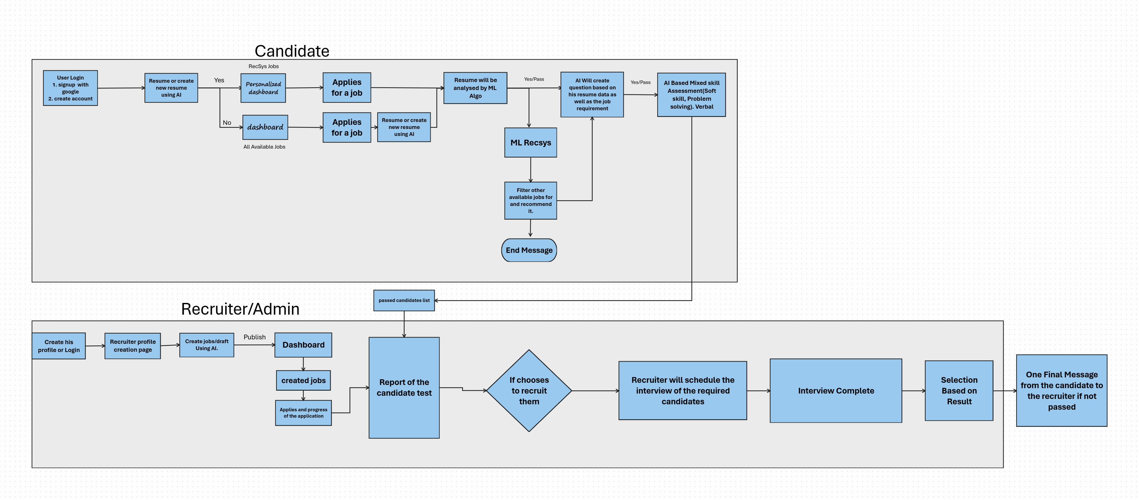
How it works

Slide 14
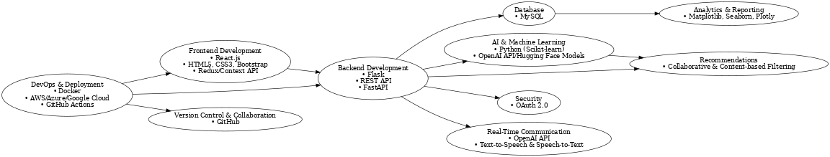
How it works

Slide 15



1. Generative AI for Resume Enhancement
Leveraging Generative AI (e.g., OpenAI) to automatically create or enhance candidate resumes based on job descriptions, skills, and experiences, making the resume creation process faster and more personalized.
Innovation & Creativity
3. Personalized Job Matching through Recommender Systems
2. AI-Driven Virtual Interviews with Real-Time Evaluation
The platform integrates AI-powered virtual interviews that not only conduct interviews but also analyze candidate responses in real-time using speech-to-text technologies, assessing both the content and sentiment of answers.
Recsys algorithms personalize job recommendations by continuously learning from user data, ensuring candidates receive the most relevant job opportunities, and helping recruiters identify the best-fit candidates more quickly.

Slide 16
Scalability, Performance and Security
Scalability: The platform can easily grow with demand by using cloud services (AWS, Azure) that auto-scale and a microservices architecture that allows different components to scale independently.
Performance: Caching with Redis speeds up data retrieval, while asynchronous processing ensures smooth operation. Fast API enables fast communication between the frontend and backend.
Security: OAuth 2.0 ensures secure logins, and data encryption keeps user information safe. The platform uses role-based access to control who can access what, and regular security tests help keep vulnerabilities in check.

Slide 17
Best practices and industry standards followed
User Experience:
Responsive design for mobile and desktop use.
Easy-to-use interface for smooth navigation.
Data Security:
Encryption for safe data storage and transfer.
OAuth 2.0 for secure login.
Scalability & Performance:
Microservices for easy scaling.
Cloud infrastructure with automatic scaling.

Slide 18
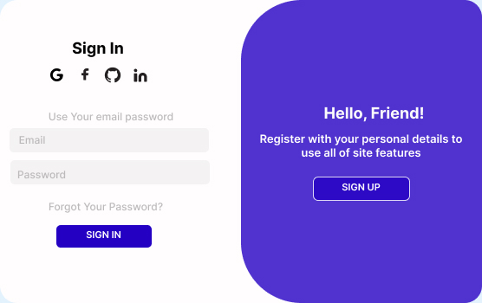
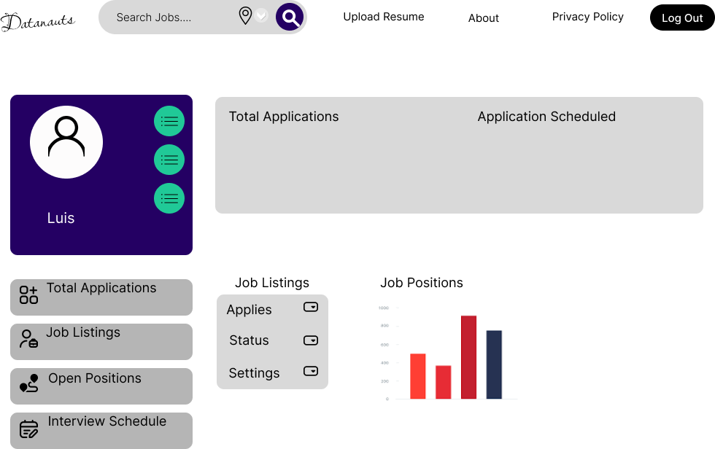
User Experience

Slide 19
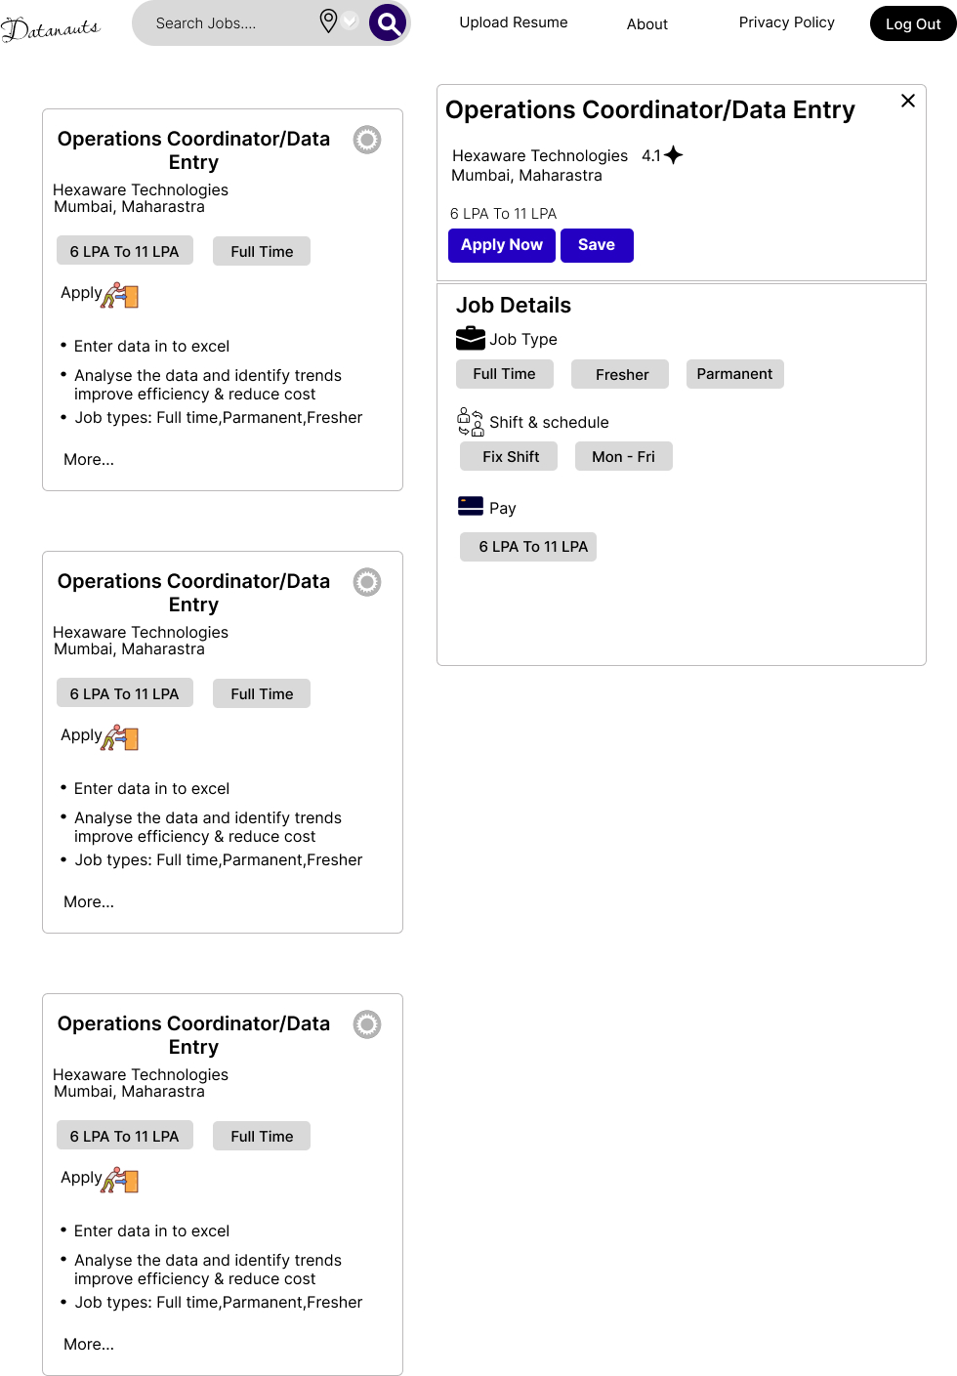
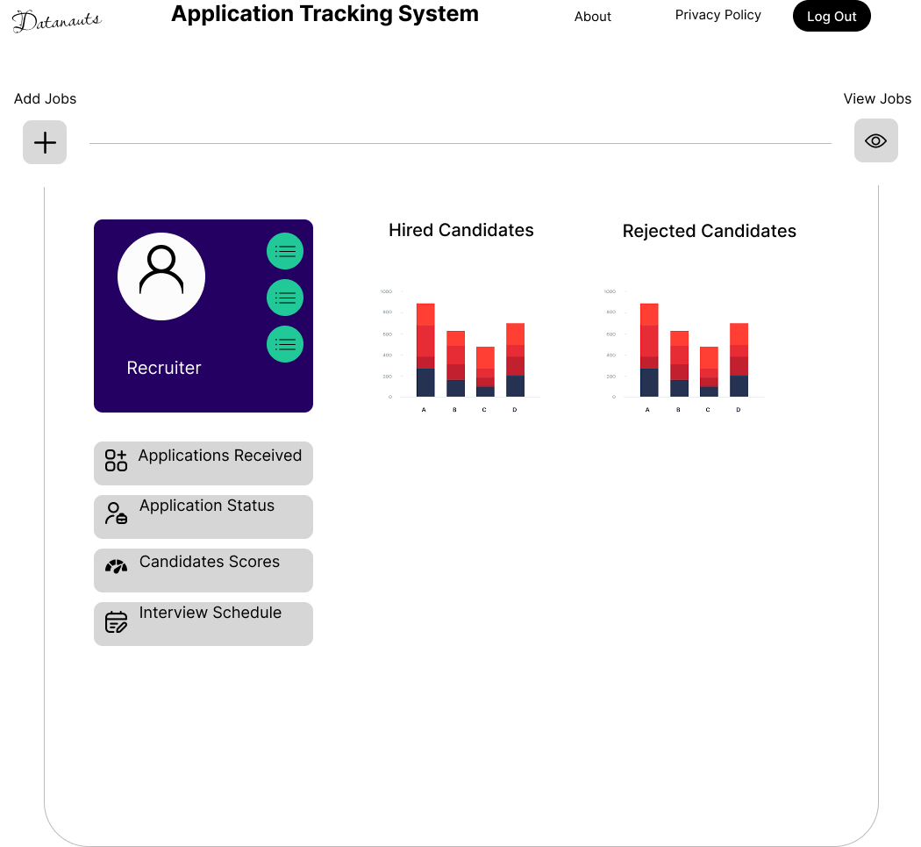
User Experience

Slide 20
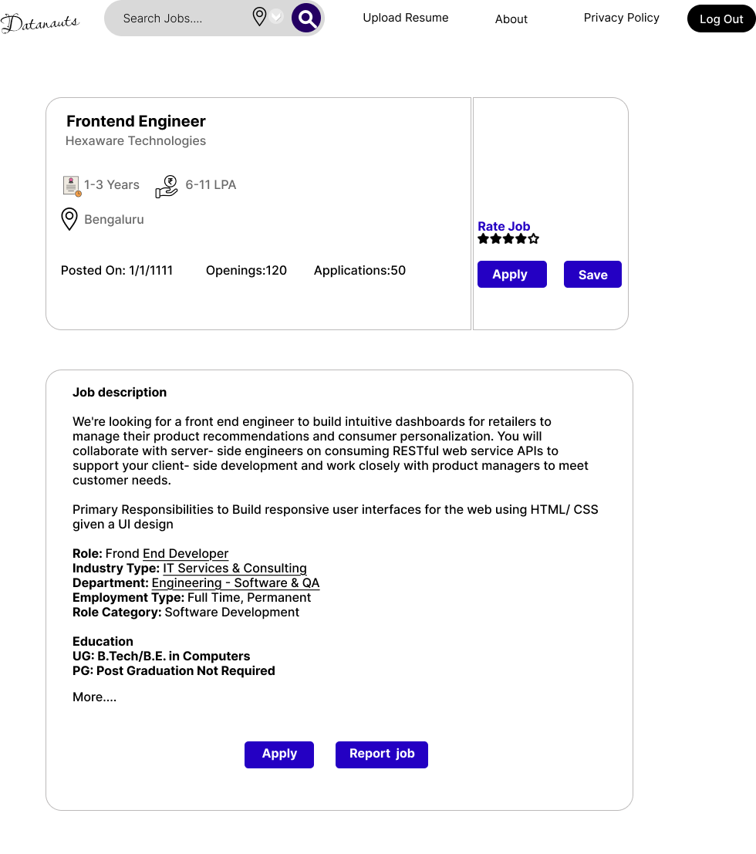
User Experience

Slide 21

THANKYOU

